Slide 1




Web development using django student management
Presentation

Slide 2
student management in django

Slide 3
Student management in django

Slide 4




Student management in django topics & contents
Design part: Establish the initial modules & the dedicated database.
Summary details of interior functions of the project.
Closely Observe for project by deploying the code and testing.
Conculsion: reaching to conclusion of the project using Django.

Slide 5
Student management in django
Design part: Establish the initial modules & the dedicated database.

Slide 6
Student management in django
HOD LOGIN (Head of Department Login – Admin)
STAFF LOGIN
Design part
features
STUDENTS LOGIN

Slide 7
Student management in django
HOD LOGIN (Head of Department Login – Admin)
Manage Students
Manage Staff
Design part
features
Send Notification
View Attendance Report
Manage Subject & Courses

Slide 8
Student management in django
Apply for leave
Student Attendance
STAFF LOGIN
Send Notice to Student
Design part
features
Staff Profile

Slide 9
Student management in django
See Notification
Feedback
Student Profile
Apply for leave
Design part
features
STUDENTS LOGIN

Slide 10
Student management in django
HOD LOGIN (Head of Department Login – Admin)
Working modules
1. Login
2. ADD/View student
3. ADD/View Staff
4. Remove Student
5. Remove Staff
6. View All Attendance Data
Design part
Working modules
7. Add/View Course
8. Add/View Subject
9. Remove Subject
10. Remove Course
11. Send Notification to Student, Staff

Slide 11
Student management in django
Working modules
1. Login
2. Apply for leave
3. Take Student Attendance
4. View Attendance Data
5. View Profile
6. View All Notification
7. Send Feedback
8. Logout
STAFF
Design part
Working modules

Slide 12
Student management in django
Working modules
1. Login
2. Apply for leave
3. View His/Her Attendance Data
4. View Notification
5. Send Feedback
6. Logout
Design part
Working modules
STUDENTS

Slide 13
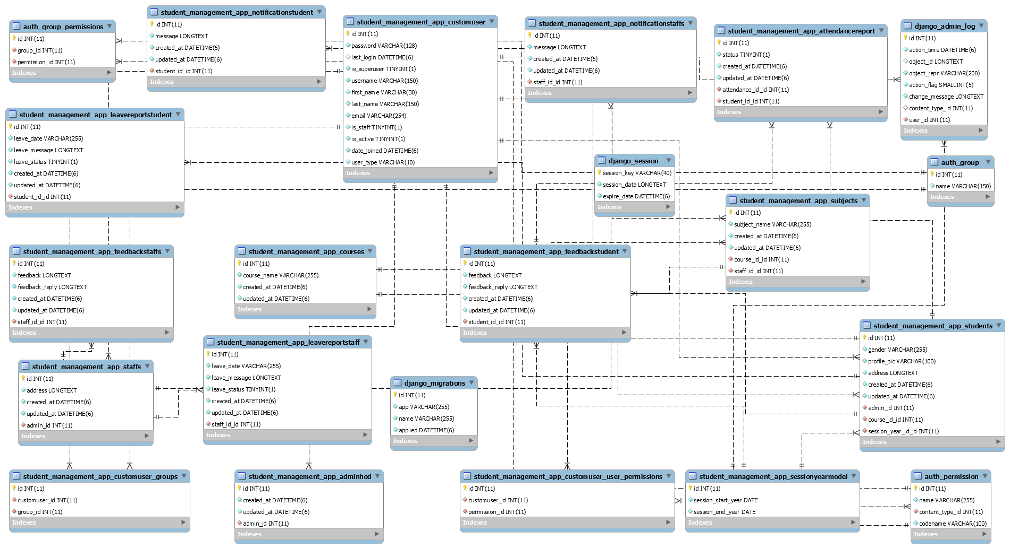
Student management in django
Design part
database

Slide 14
Student management in django
Design part: Establish the initial features & modules & the dedicated database.

Slide 15
Student management in django
Design part: Establish the initial features & modules & the dedicated database.
Summary details of interior functions of the project.
Closely Observe for project by deploying the code and testing.
Conculsion: reaching to conclusion of the project using Django.

Slide 16

Student management in django
Summary details
Summary details of interior functions of the project.

Slide 17
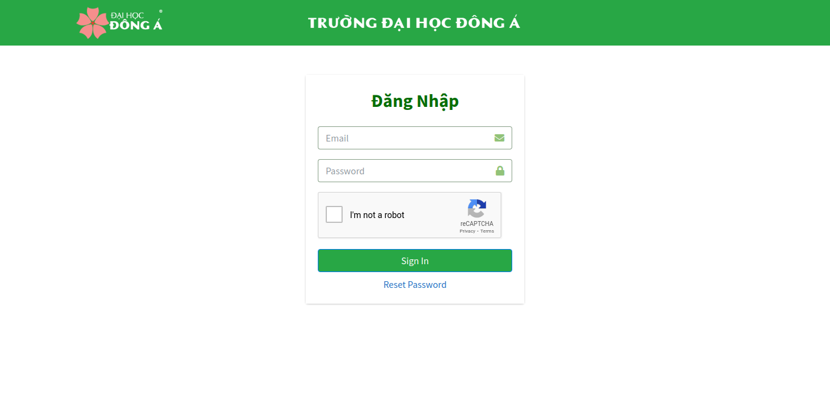
Student management in django
Summary details
login

Slide 18
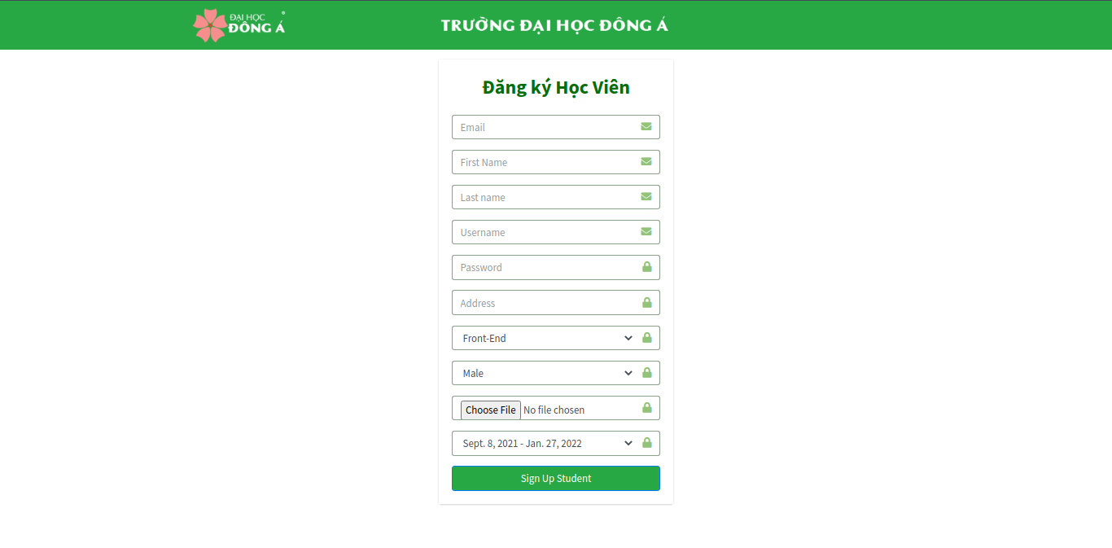
Student management in django
Summary details
Register student

Slide 19
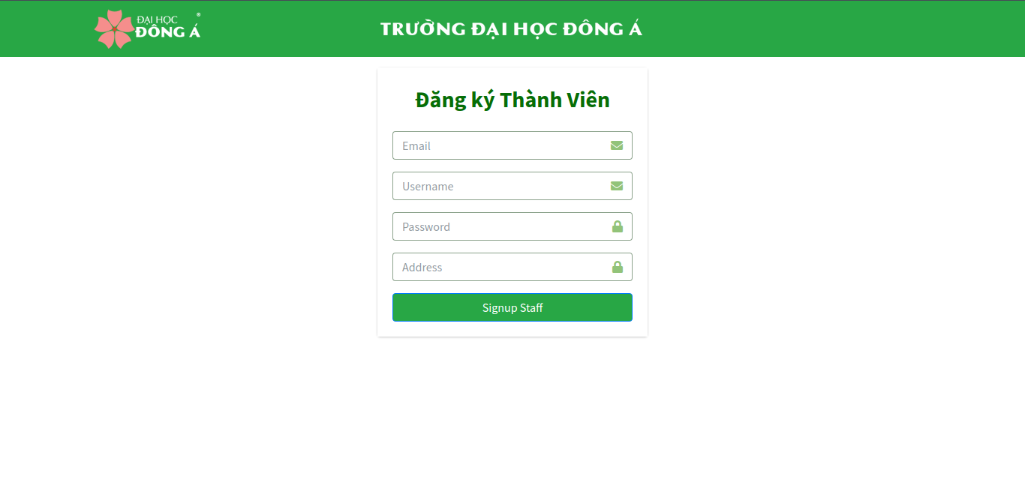
Student management in django
Summary details
Register staff

Slide 20
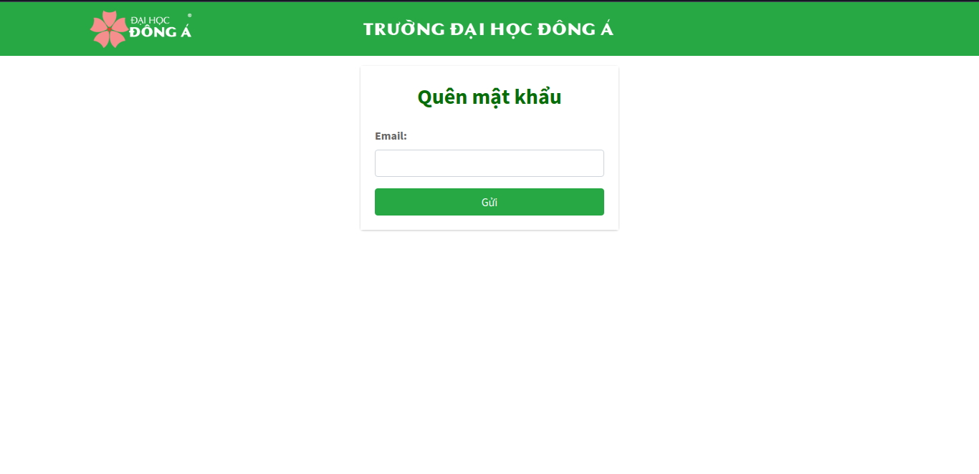
Student management in django
Summary details
Reset password

Slide 21
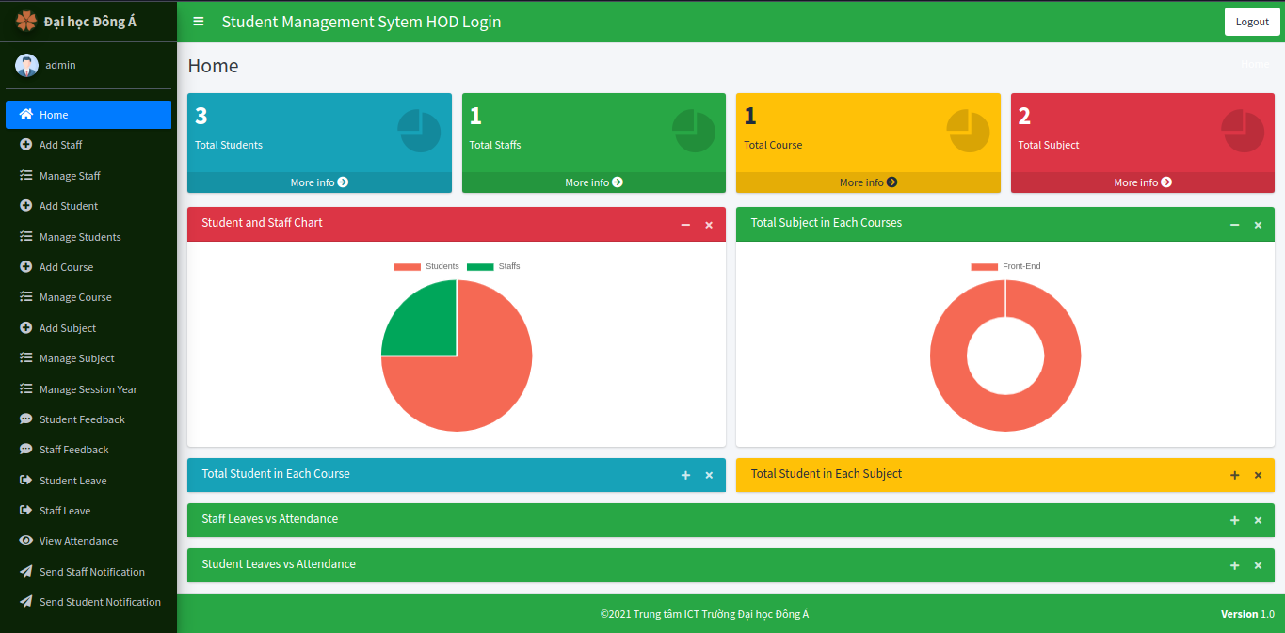
Student management in django
Home
Add Staff
Manage Staff
Add Student
Manage Students
Add Course
Hod admin
Manage Course
Add Subject
Manage Subject

Slide 22
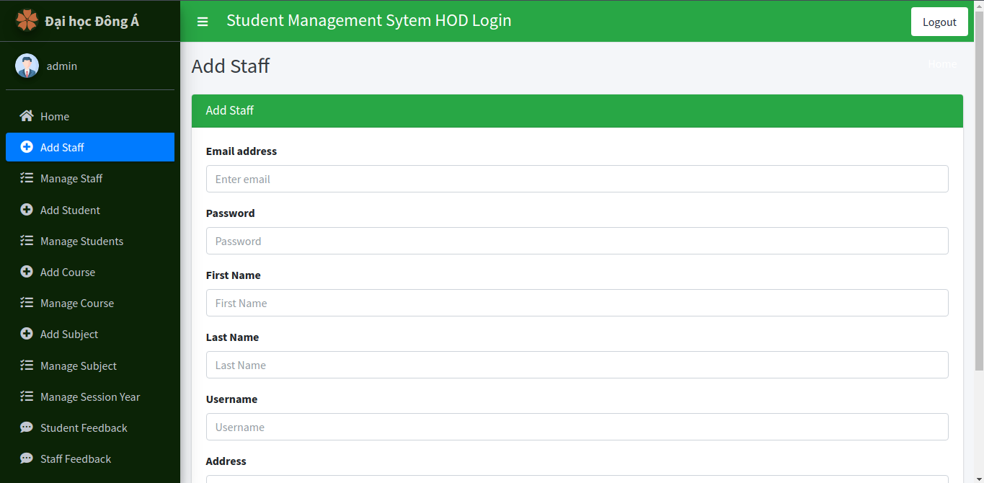
Student management in django
Home
Add Staff
Manage Staff
Add Student
Manage Students
Add Course
Hod admin
Manage Course
Add Subject
Manage Subject

Slide 23
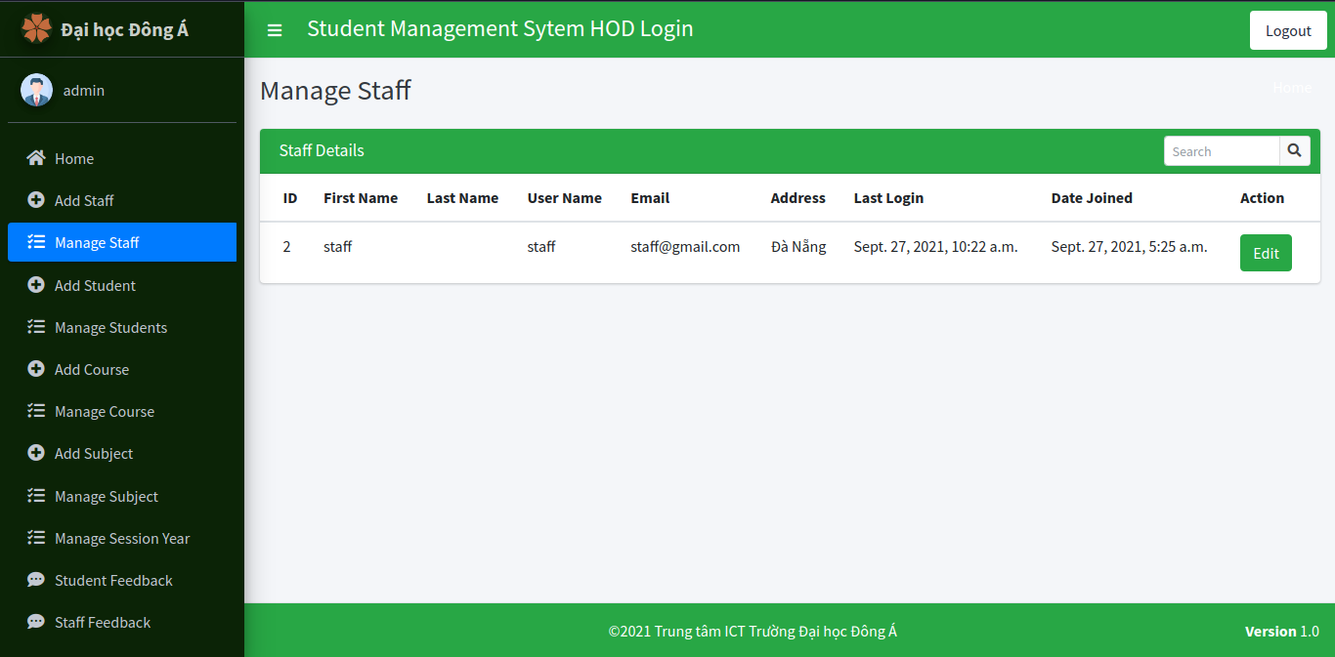
Student management in django
Home
Add Staff
Manage Staff
Add Student
Manage Students
Add Course
Hod admin
Manage Course
Add Subject
Manage Subject

Slide 24
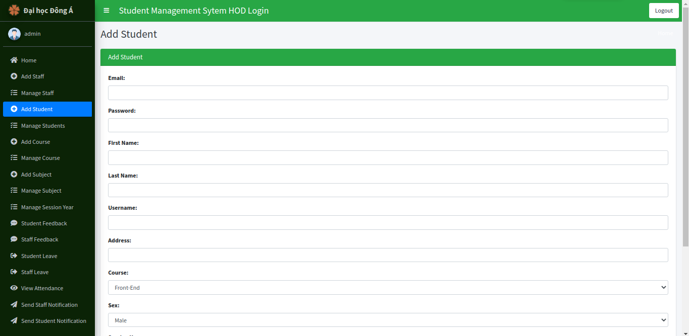
Student management in django
Home
Add Staff
Manage Staff
Add Student
Manage Students
Add Course
Hod admin
Manage Course
Add Subject
Manage Subject

Slide 25
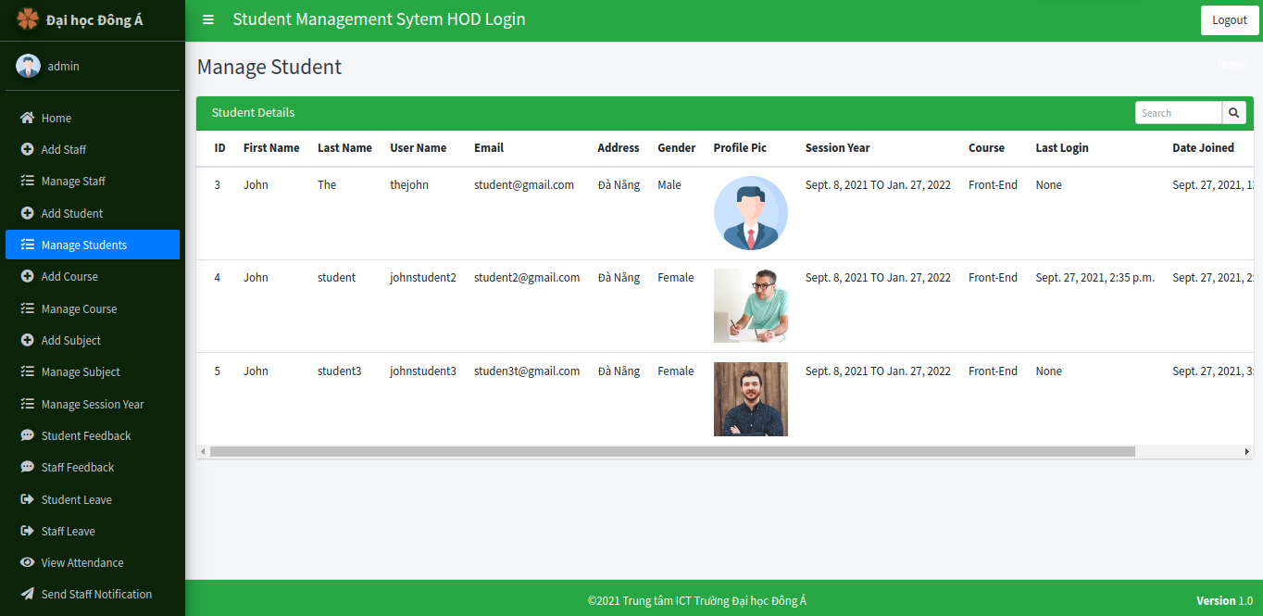
Student management in django
Home
Add Staff
Manage Staff
Add Student
Manage Students
Add Course
Hod admin
Manage Course
Add Subject
Manage Subject

Slide 26
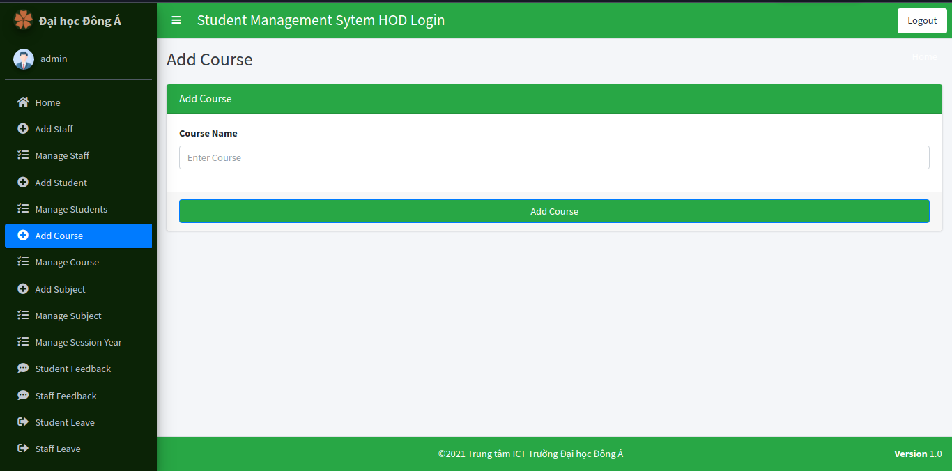
Student management in django
Home
Add Staff
Manage Staff
Add Student
Manage Students
Add Course
Hod admin
Manage Course
Add Subject
Manage Subject

Slide 27
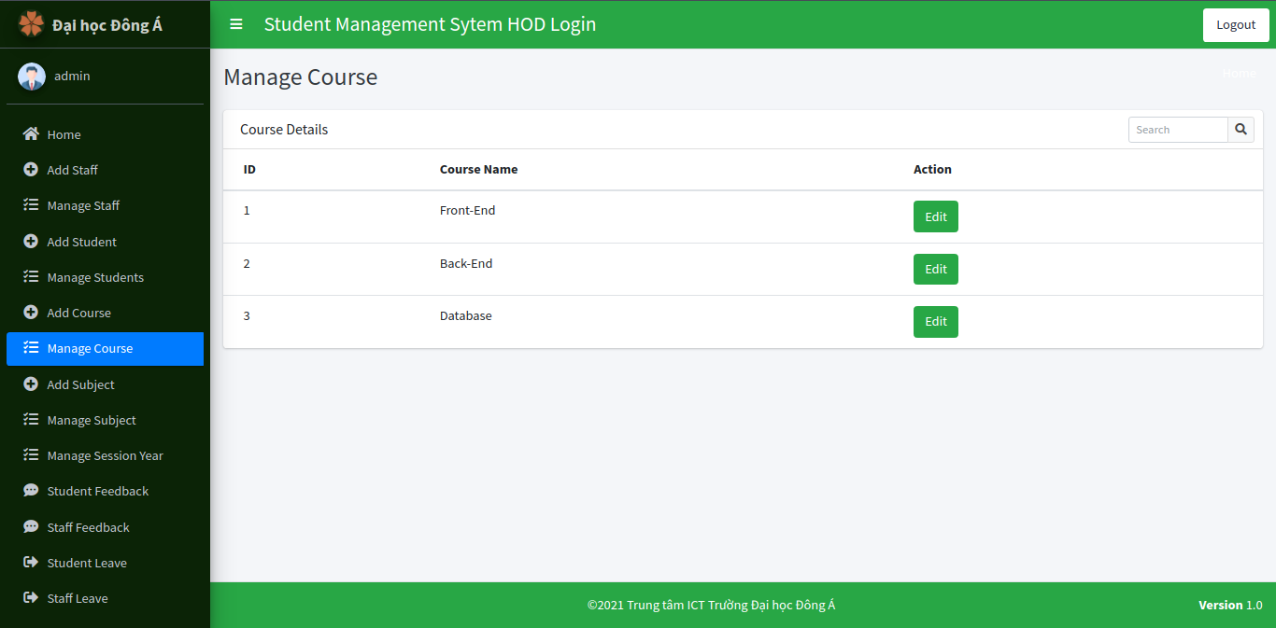
Student management in django
Home
Add Staff
Manage Staff
Add Student
Manage Students
Add Course
Hod admin
Manage Course
Add Subject
Manage Subject

Slide 28
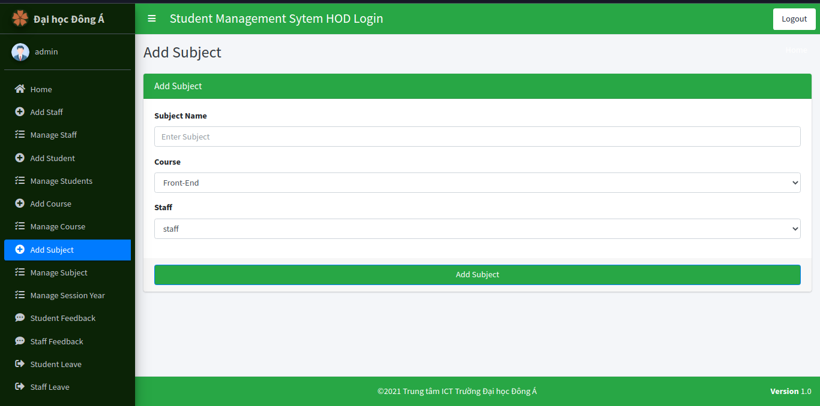
Student management in django
Home
Add Staff
Manage Staff
Add Student
Manage Students
Add Course
Hod admin
Manage Course
Add Subject
Manage Subject

Slide 29
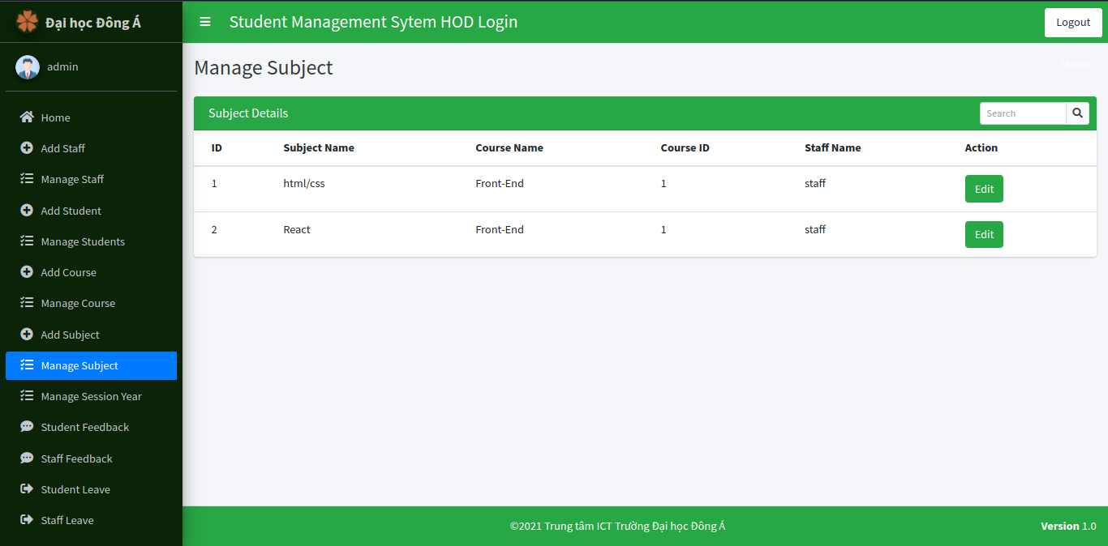
Student management in django
Home
Add Staff
Manage Staff
Add Student
Manage Students
Add Course
Hod admin
Manage Course
Add Subject
Manage Subject

Slide 30
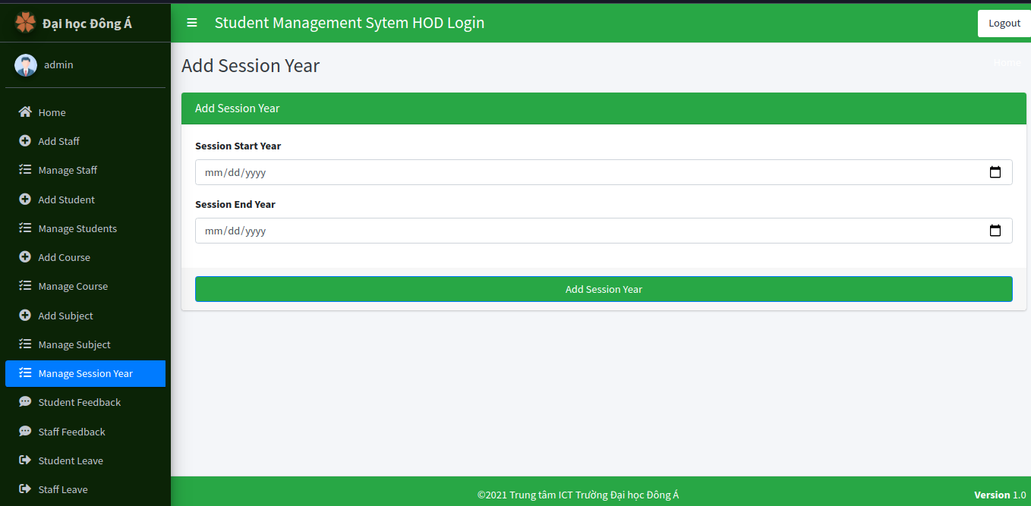
Student management in django
Manage Session Year
Student Feedback
Staff Feedback
Student Leave
Staff Leave
View Attendance
Hod admin
Send Staff Notification
Send Student Notification

Slide 31
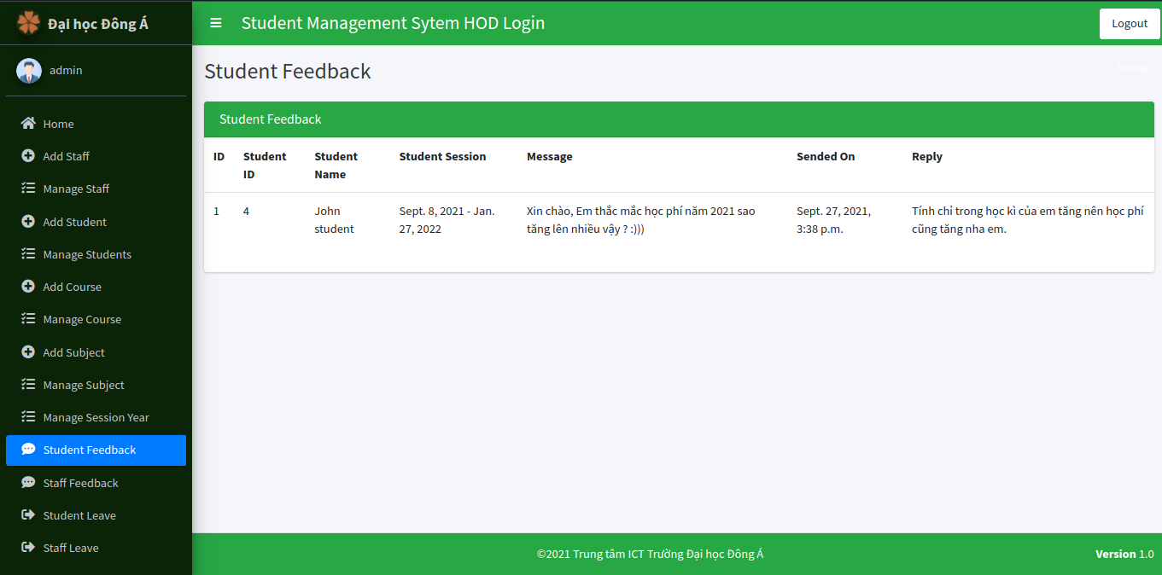
Student management in django
Manage Session Year
Student Feedback
Staff Feedback
Student Leave
Staff Leave
View Attendance
Hod admin
Send Staff Notification
Send Student Notification

Slide 32
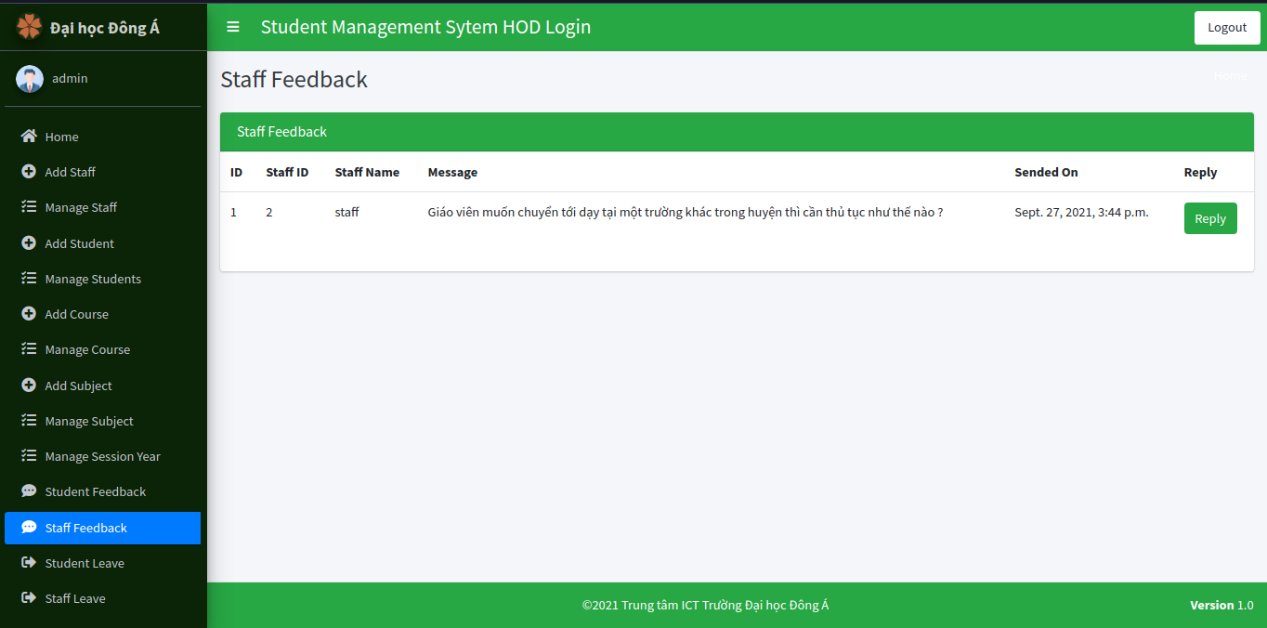
Student management in django
Manage Session Year
Student Feedback
Staff Feedback
Student Leave
Staff Leave
View Attendance
Hod admin
Send Staff Notification
Send Student Notification

Slide 33
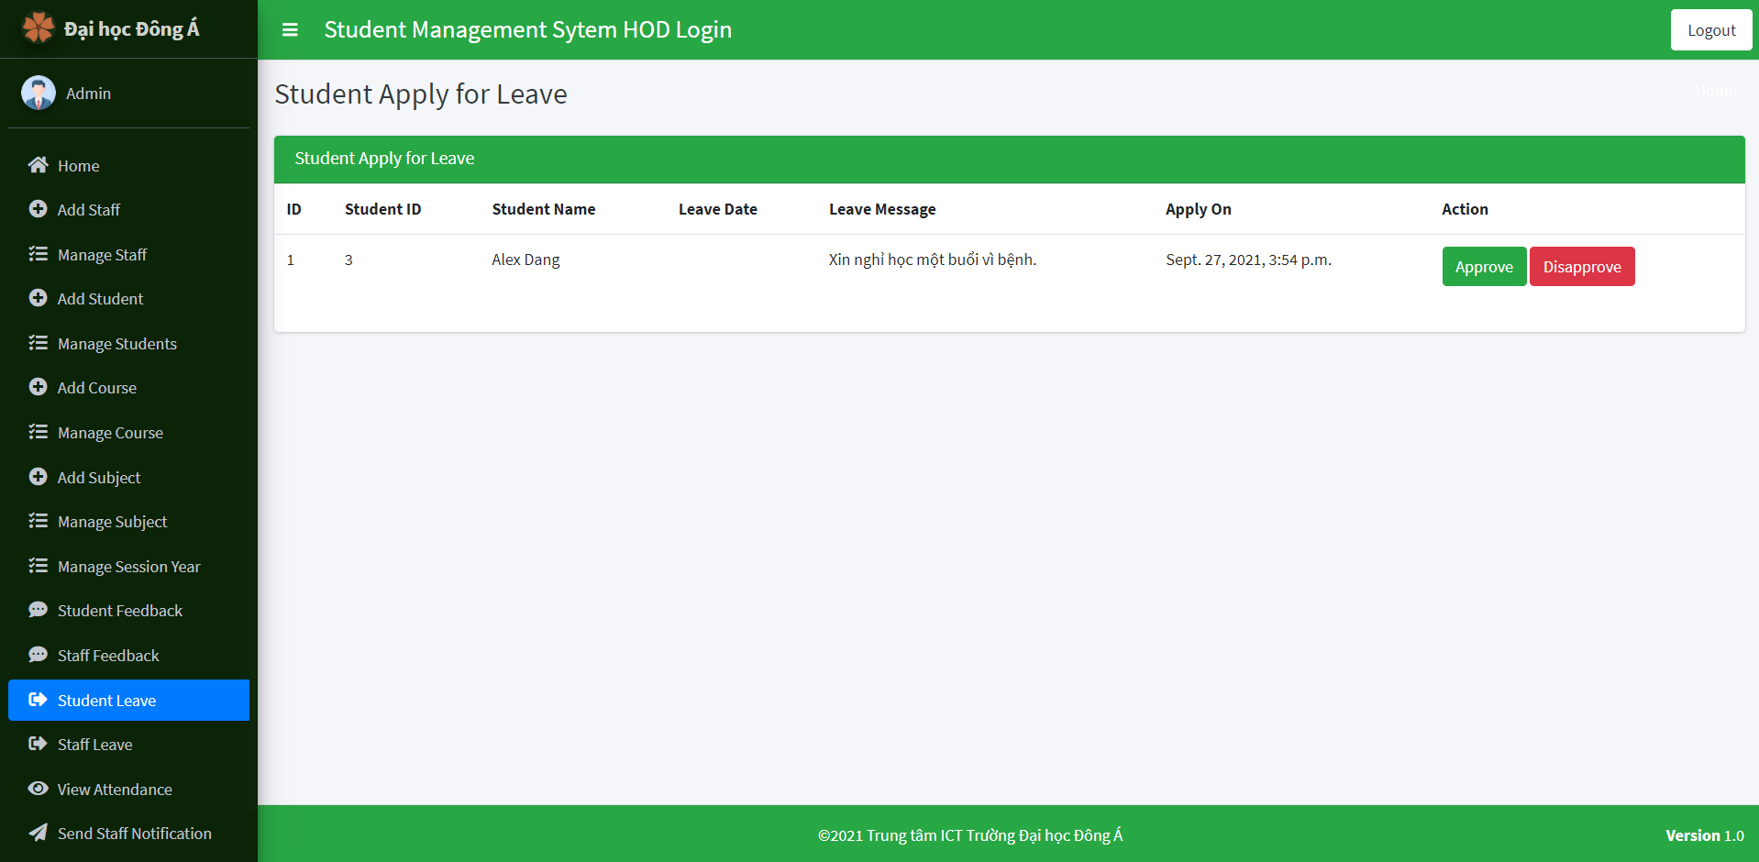
Student management in django
Manage Session Year
Student Feedback
Staff Feedback
Student Leave
Staff Leave
View Attendance
Hod admin
Send Staff Notification
Send Student Notification

Slide 34
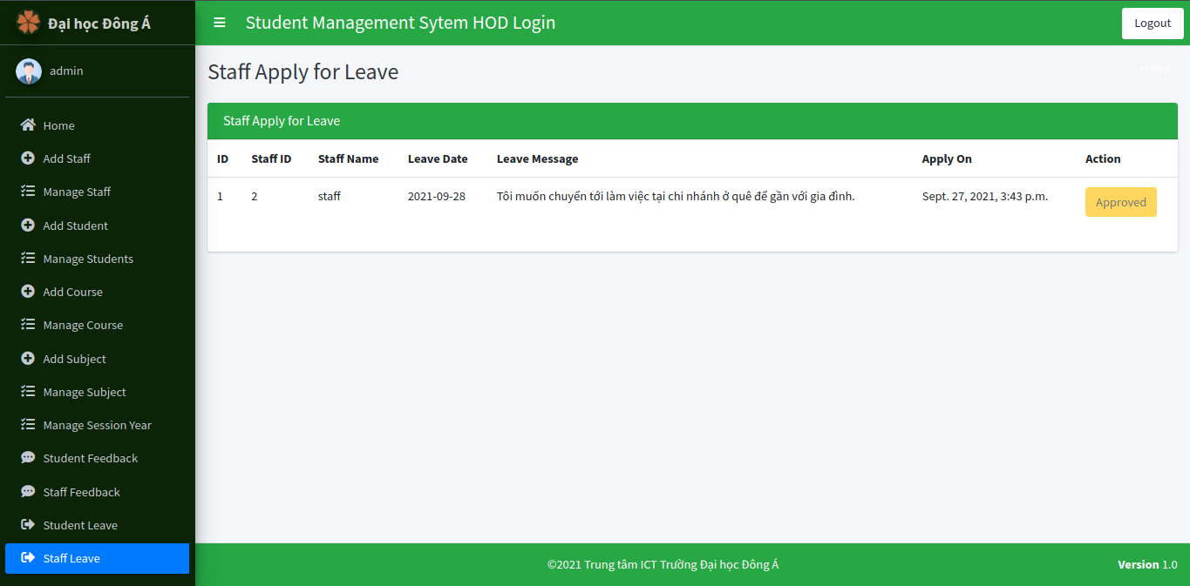
Student management in django
Manage Session Year
Student Feedback
Staff Feedback
Student Leave
Staff Leave
View Attendance
Hod admin
Send Staff Notification
Send Student Notification

Slide 35
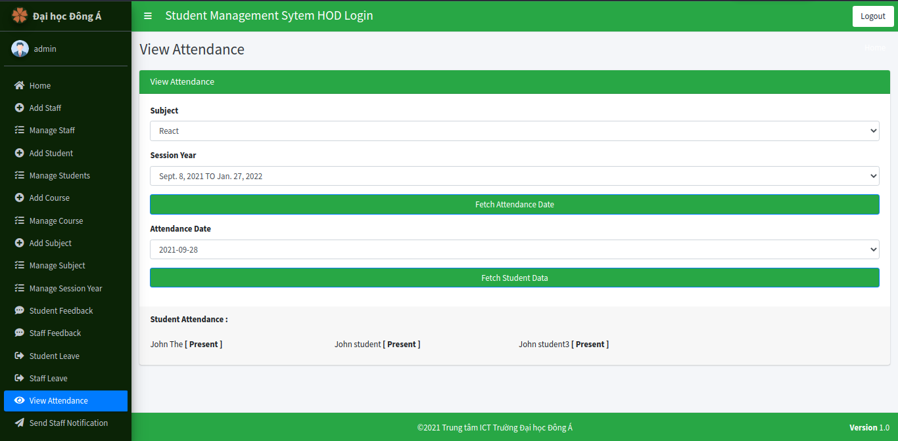
Student management in django
Manage Session Year
Student Feedback
Staff Feedback
Student Leave
Staff Leave
View Attendance
Hod admin
Send Staff Notification
Send Student Notification

Slide 36
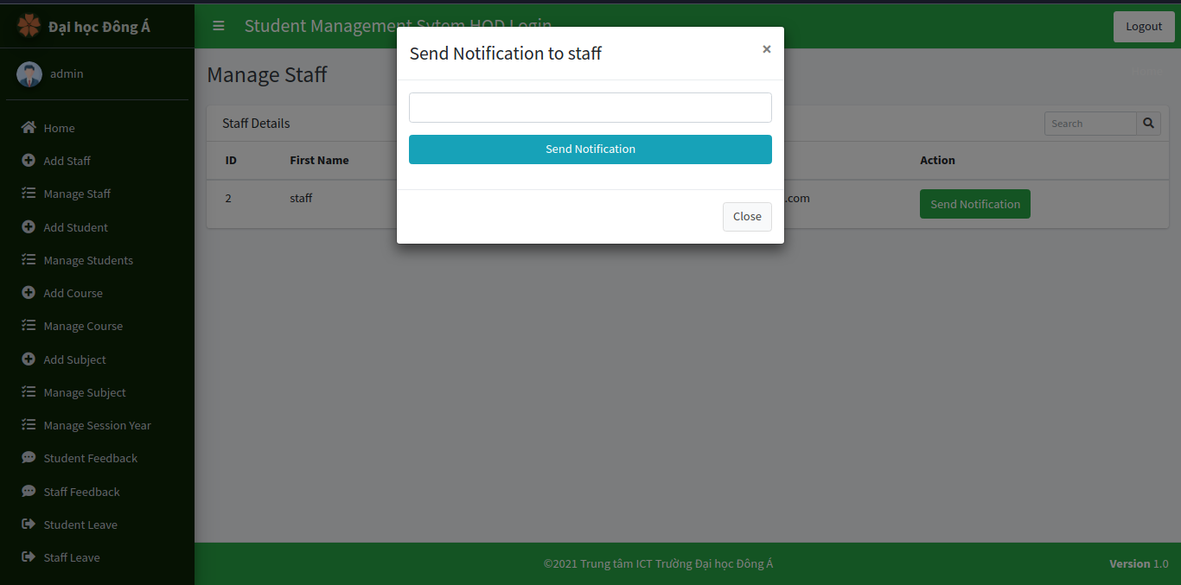
Student management in django
Manage Session Year
Student Feedback
Staff Feedback
Student Leave
Staff Leave
View Attendance
Hod admin
Send Staff Notification
Send Student Notification

Slide 37
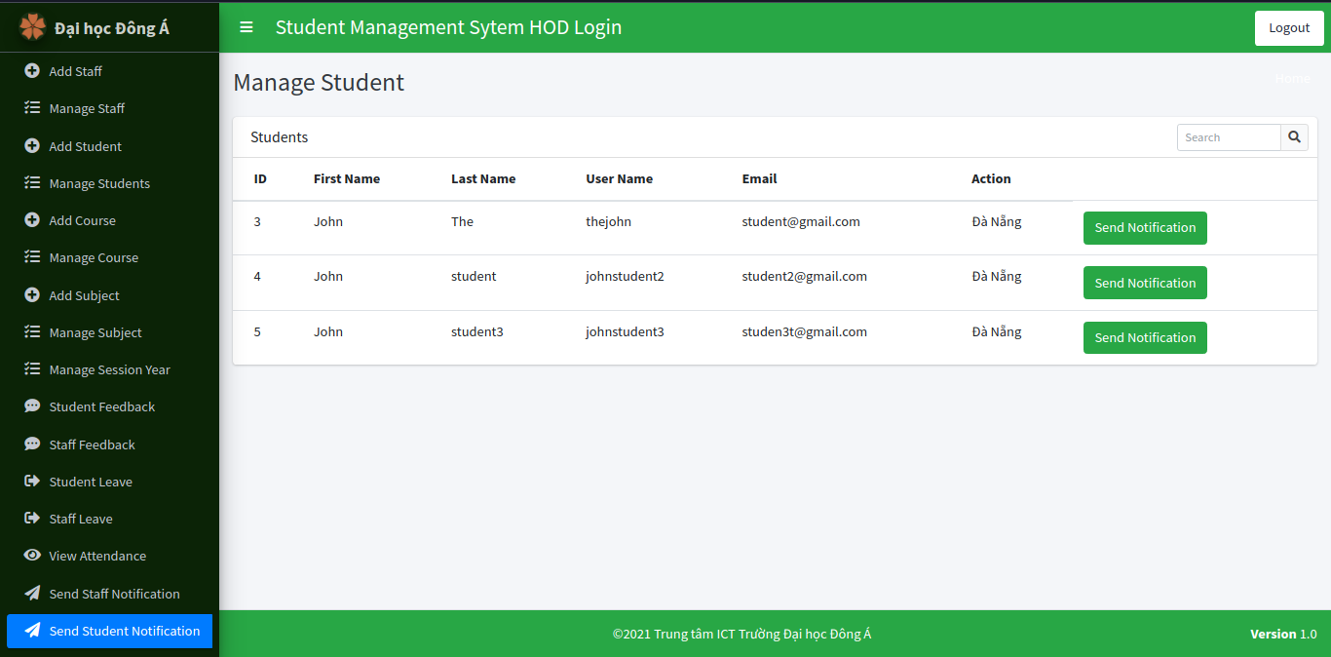
Student management in django
Manage Session Year
Student Feedback
Staff Feedback
Student Leave
Staff Leave
View Attendance
Hod admin
Send Staff Notification
Send Student Notification

Slide 38
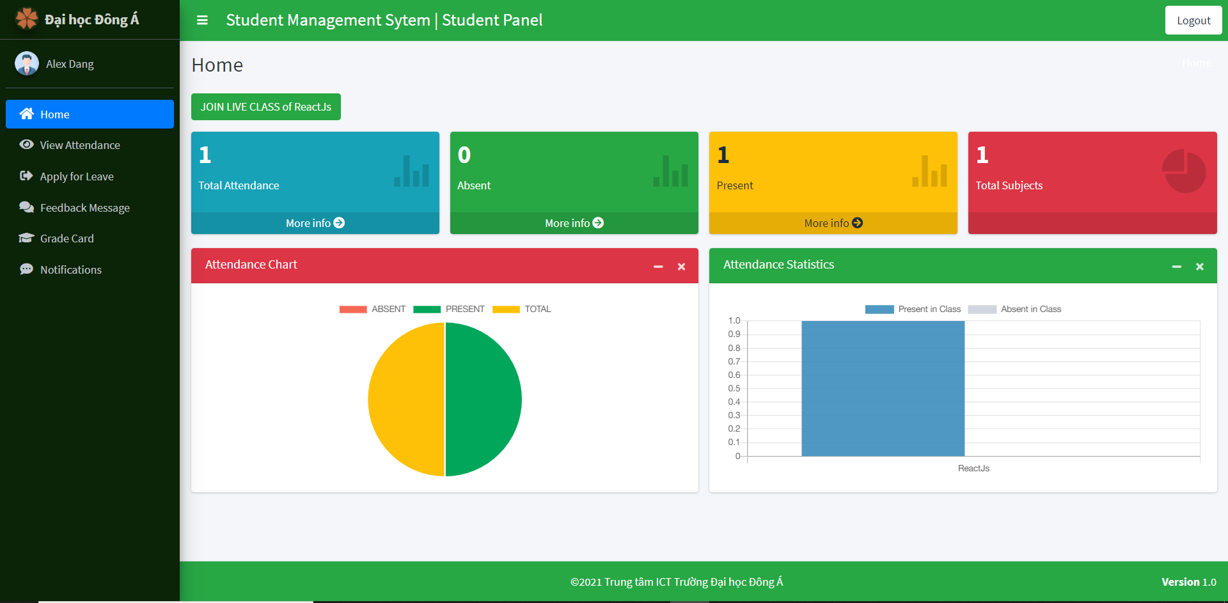
Student management in django
Home
View Attendance Data
Apply for leave
Feedback Message
Grade Card
Students
Notification

Slide 39
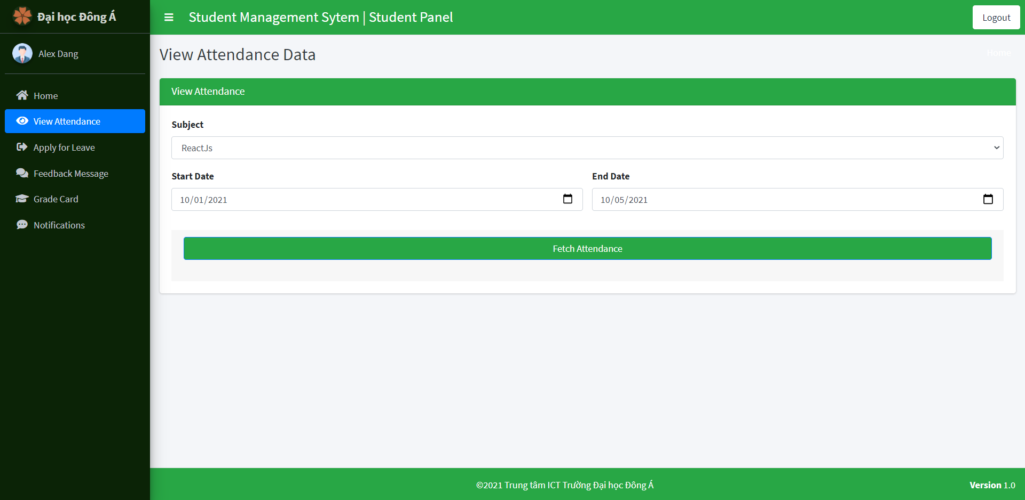
Student management in django
Home
View Attendance Data
Apply for leave
Feedback Message
Grade Card
Students
Notification

Slide 40
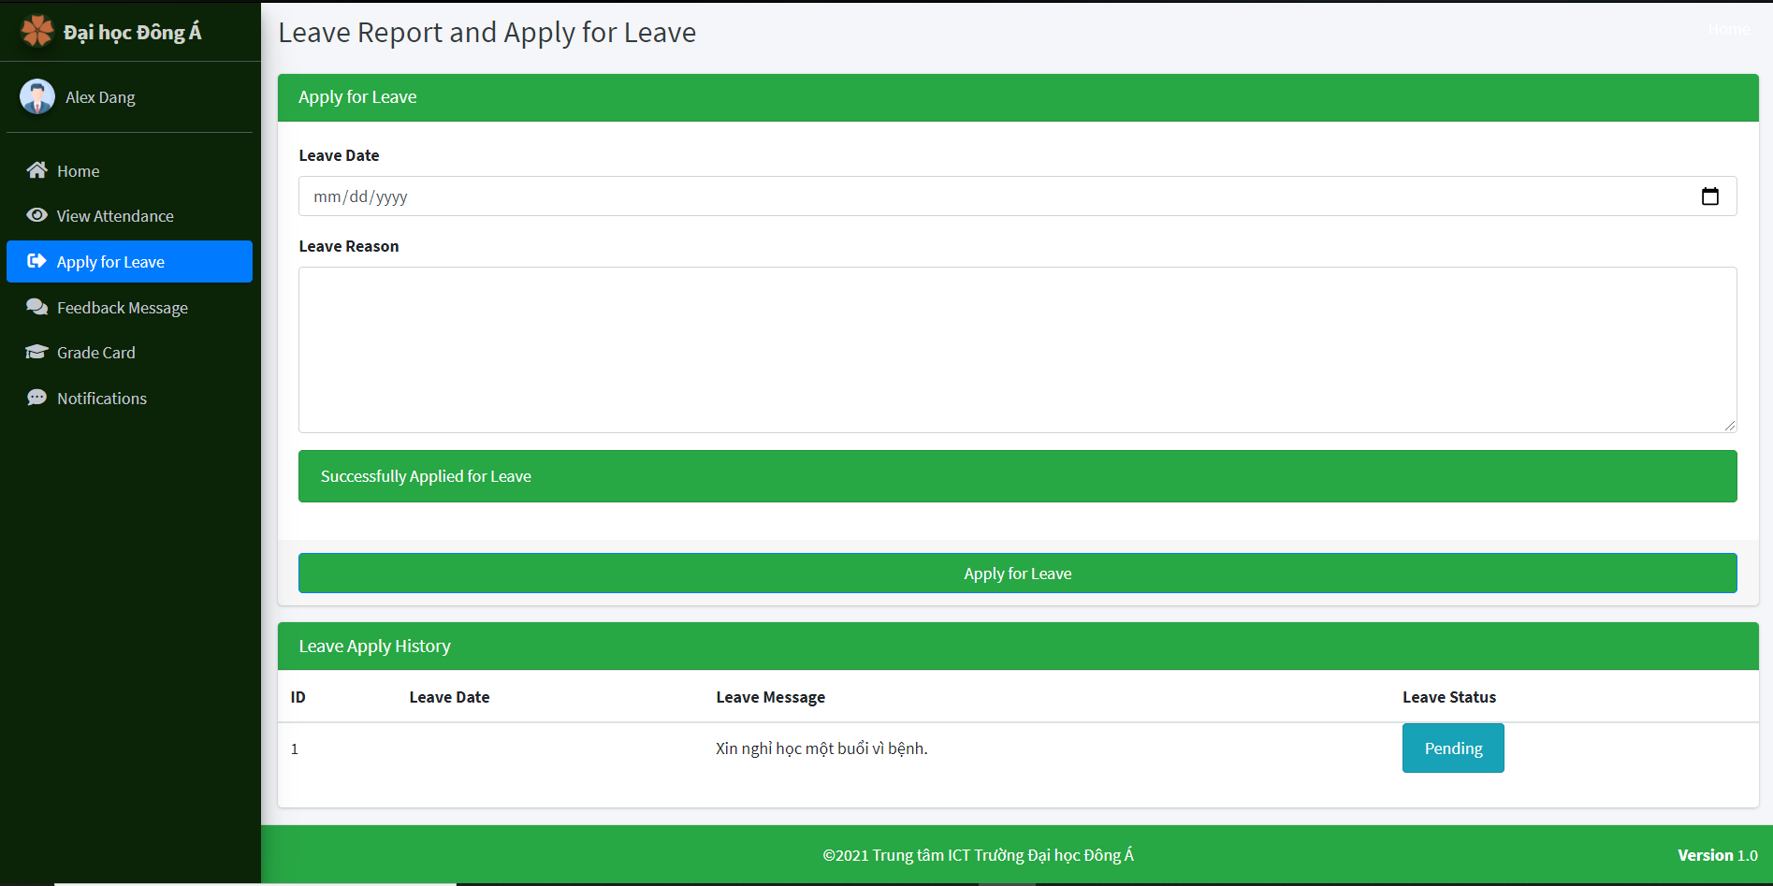
Student management in django
Home
View Attendance Data
Apply for leave
Feedback Message
Grade Card
Students
Notification

Slide 41
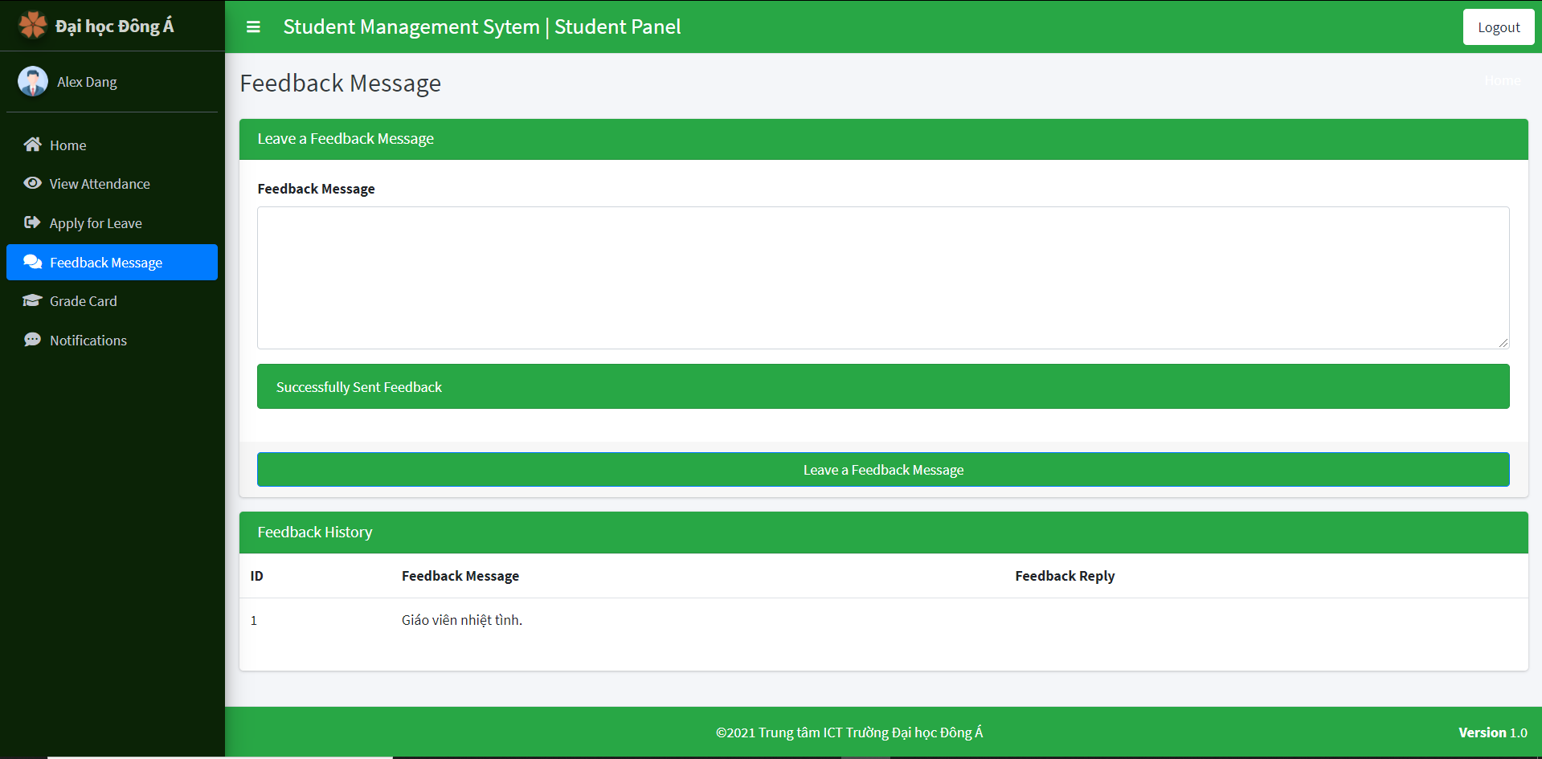
Student management in django
Home
View Attendance Data
Apply for leave
Feedback Message
Grade Card
Students
Notification

Slide 42
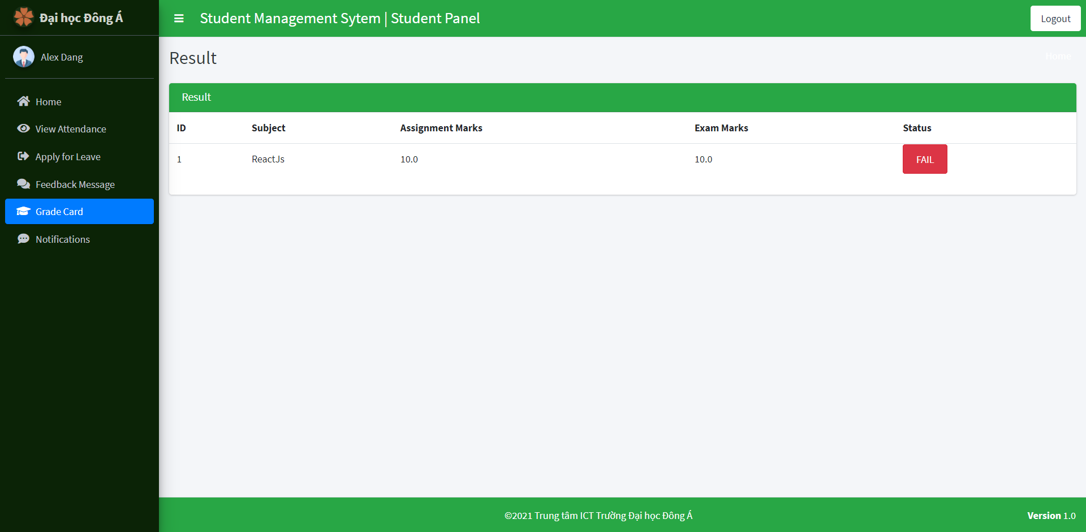
Student management in django
Home
View Attendance Data
Apply for leave
Feedback Message
Grade Card
Students
Notification

Slide 43
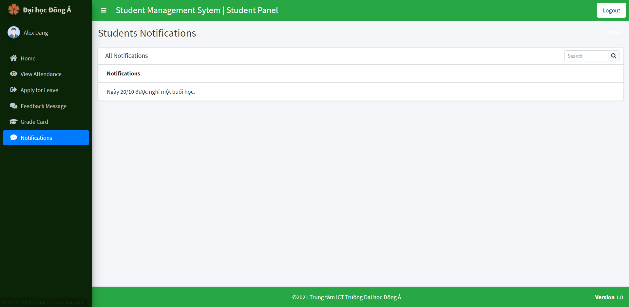
Student management in django
Home
View Attendance Data
Apply for leave
Feedback Message
Grade Card
Students
Notification

Slide 44
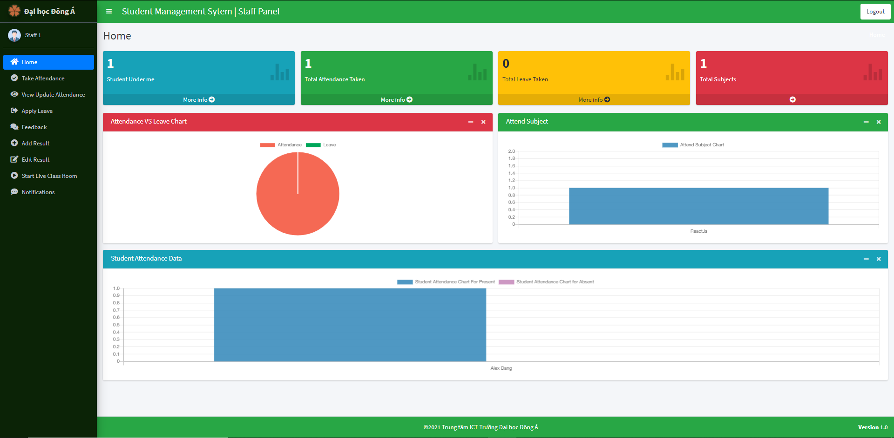
Student management in django
Home
Take Attendance
View Update Attendance
Apply Leave
Feedback
Add Result
Staff
Edit Result
Start Live Classroom
Notifications

Slide 45
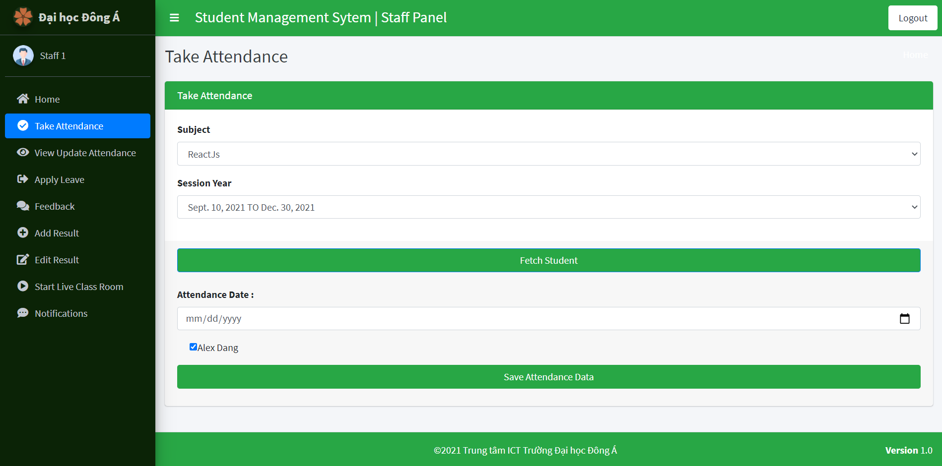
Student management in django
Home
Take Attendance
View Update Attendance
Apply Leave
Feedback
Add Result
Staff
Edit Result
Start Live Classroom
Notifications

Slide 46
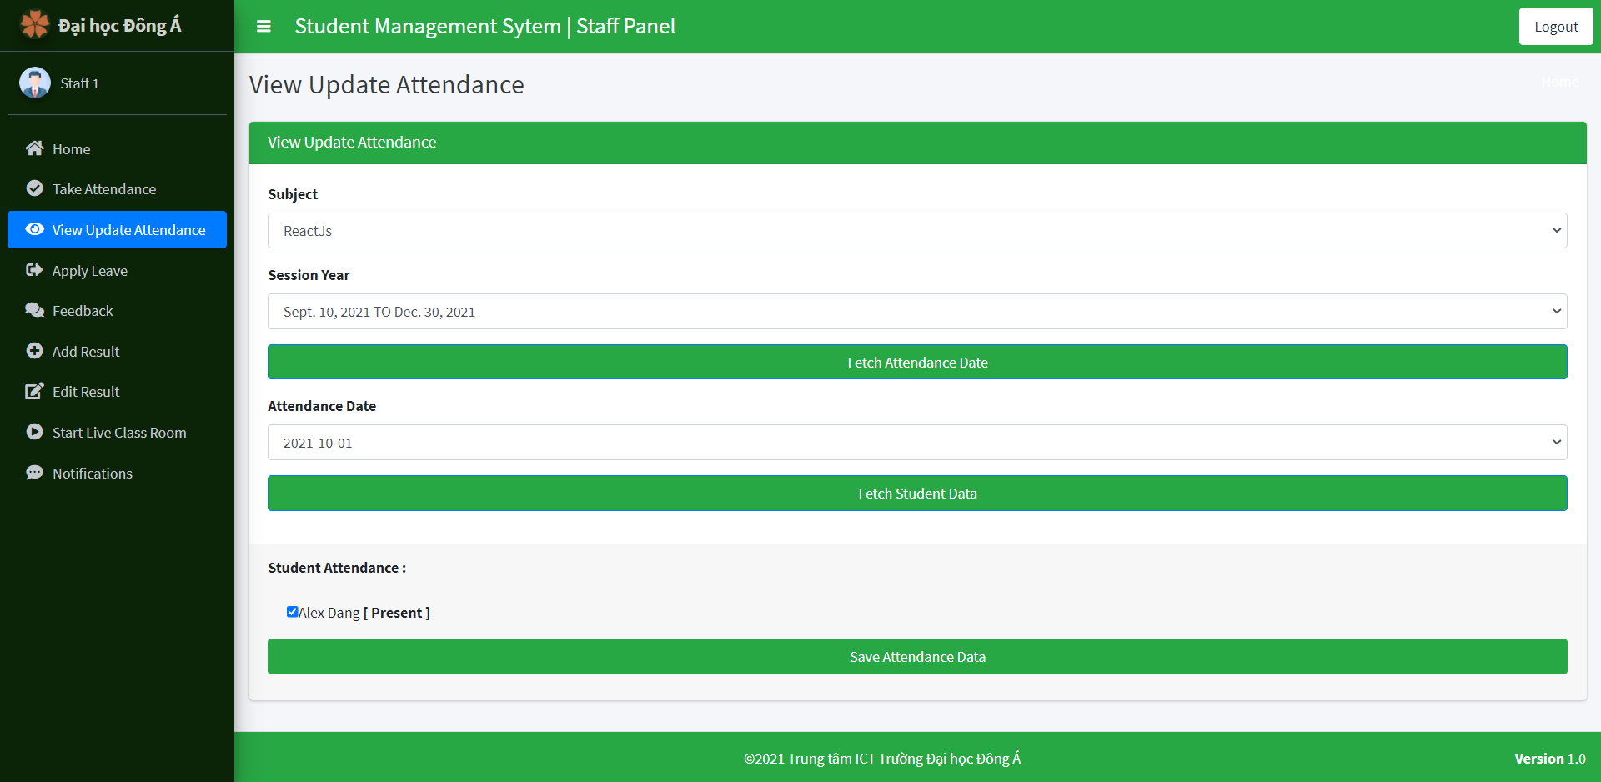
Student management in django
Home
Take Attendance
View Update Attendance
Apply Leave
Feedback
Add Result
Staff
Edit Result
Start Live Classroom
Notifications

Slide 47
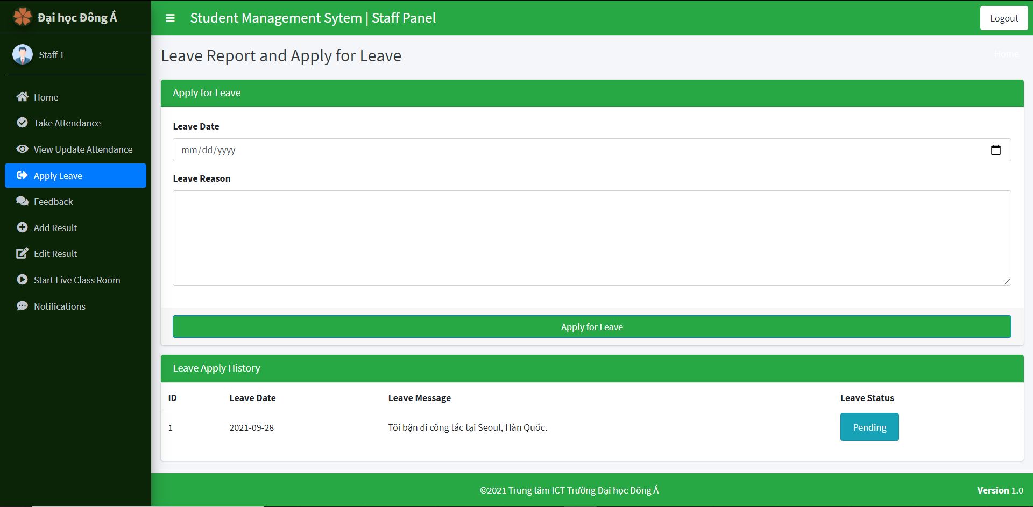
Student management in django
Home
Take Attendance
View Update Attendance
Apply Leave
Feedback
Add Result
Staff
Edit Result
Start Live Classroom
Notifications

Slide 48
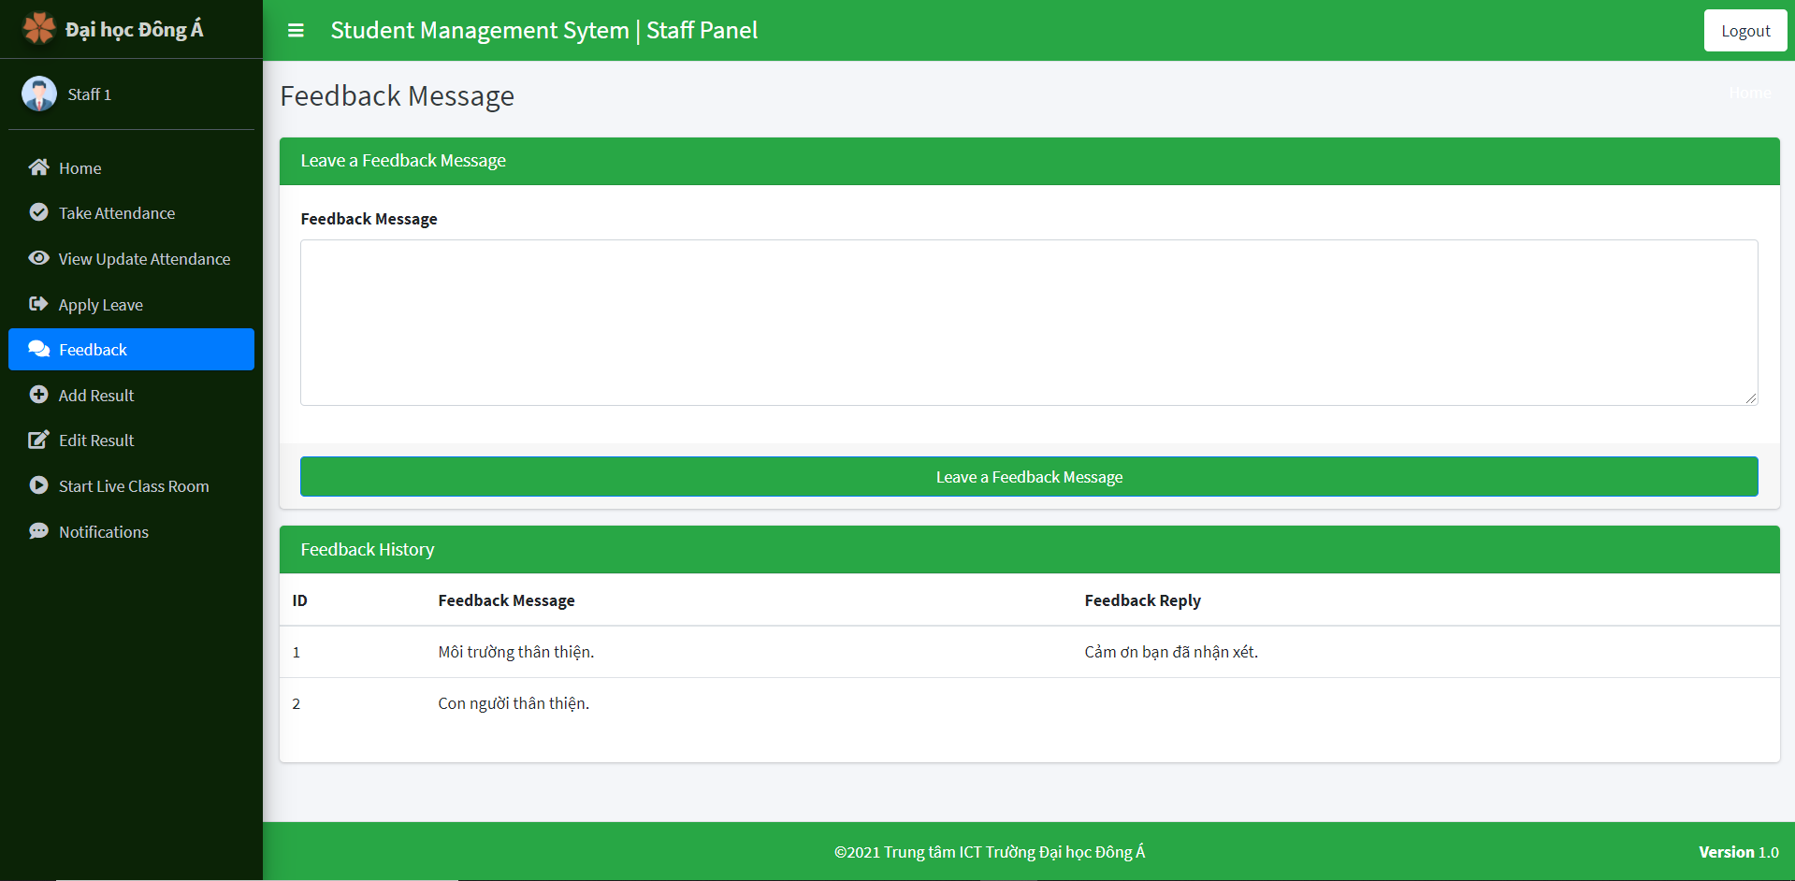
Student management in django
Home
Take Attendance
View Update Attendance
Apply Leave
Feedback
Add Result
Staff
Edit Result
Start Live Classroom
Notifications

Slide 49
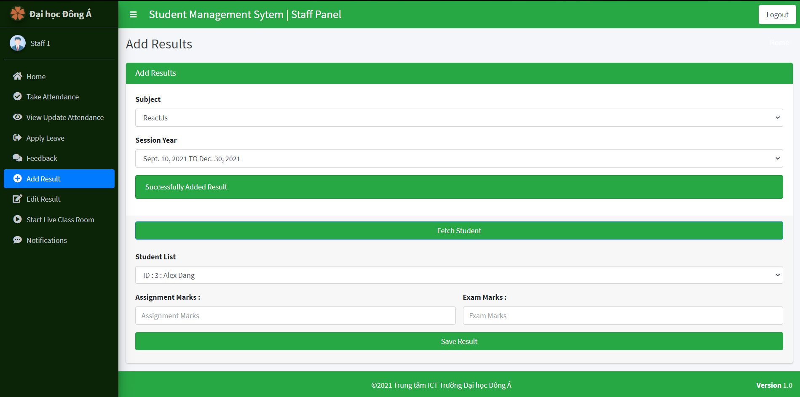
Student management in django
Home
Take Attendance
View Update Attendance
Apply Leave
Feedback
Add Result
Staff
Edit Result
Start Live Classroom
Notifications

Slide 50
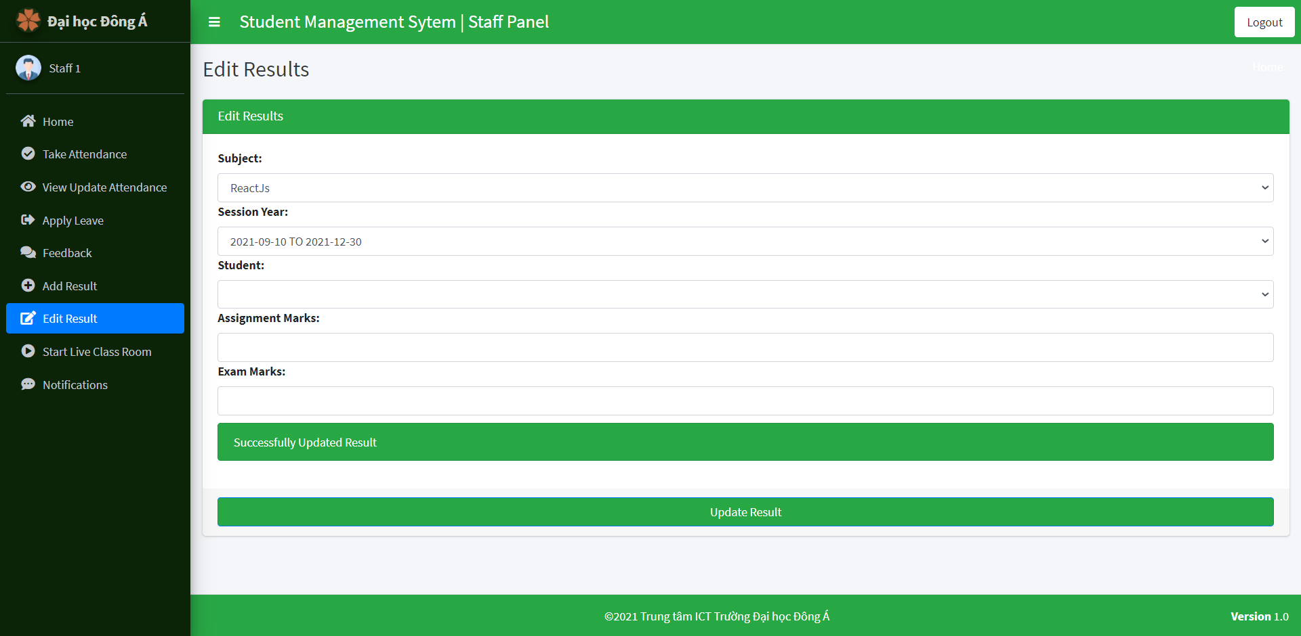
Student management in django
Home
Take Attendance
View Update Attendance
Apply Leave
Feedback
Add Result
Staff
Edit Result
Start Live Classroom
Notifications

Slide 51
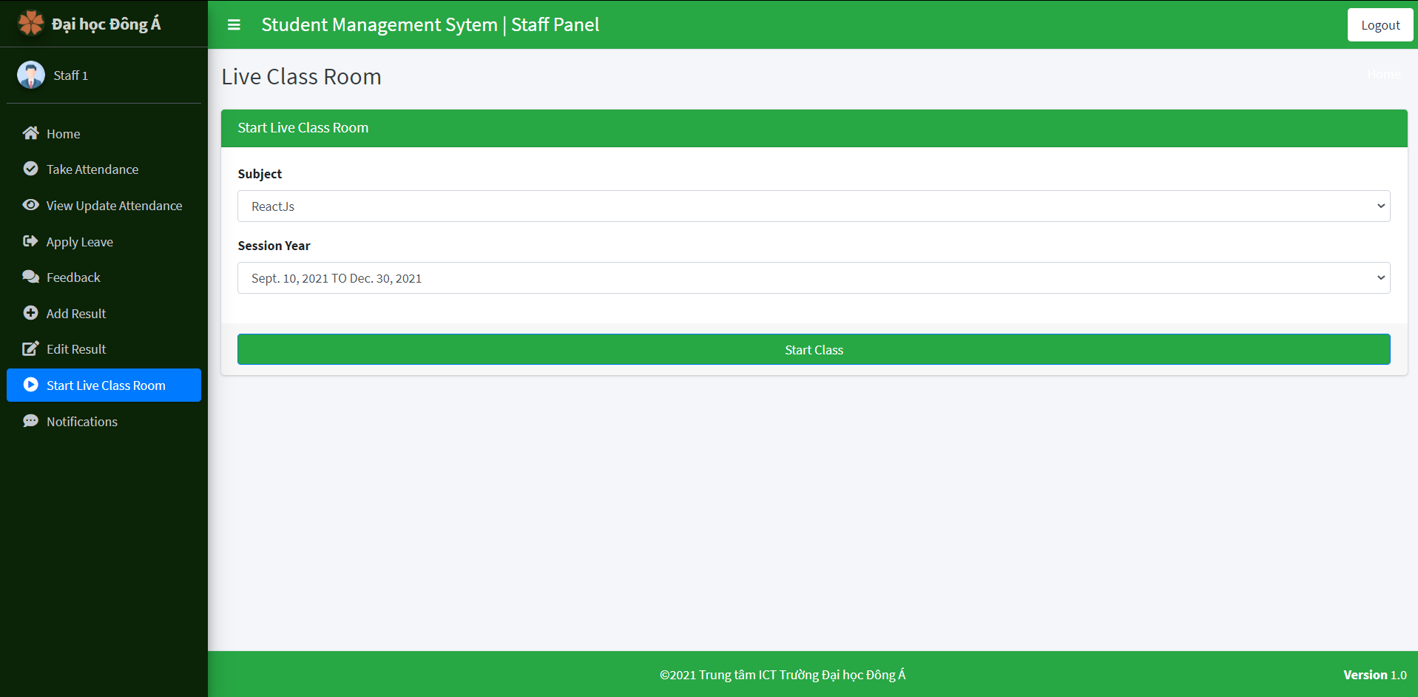
Student management in django
Home
Take Attendance
View Update Attendance
Apply Leave
Feedback
Add Result
Staff
Edit Result
Start Live Classroom
Notifications

Slide 52
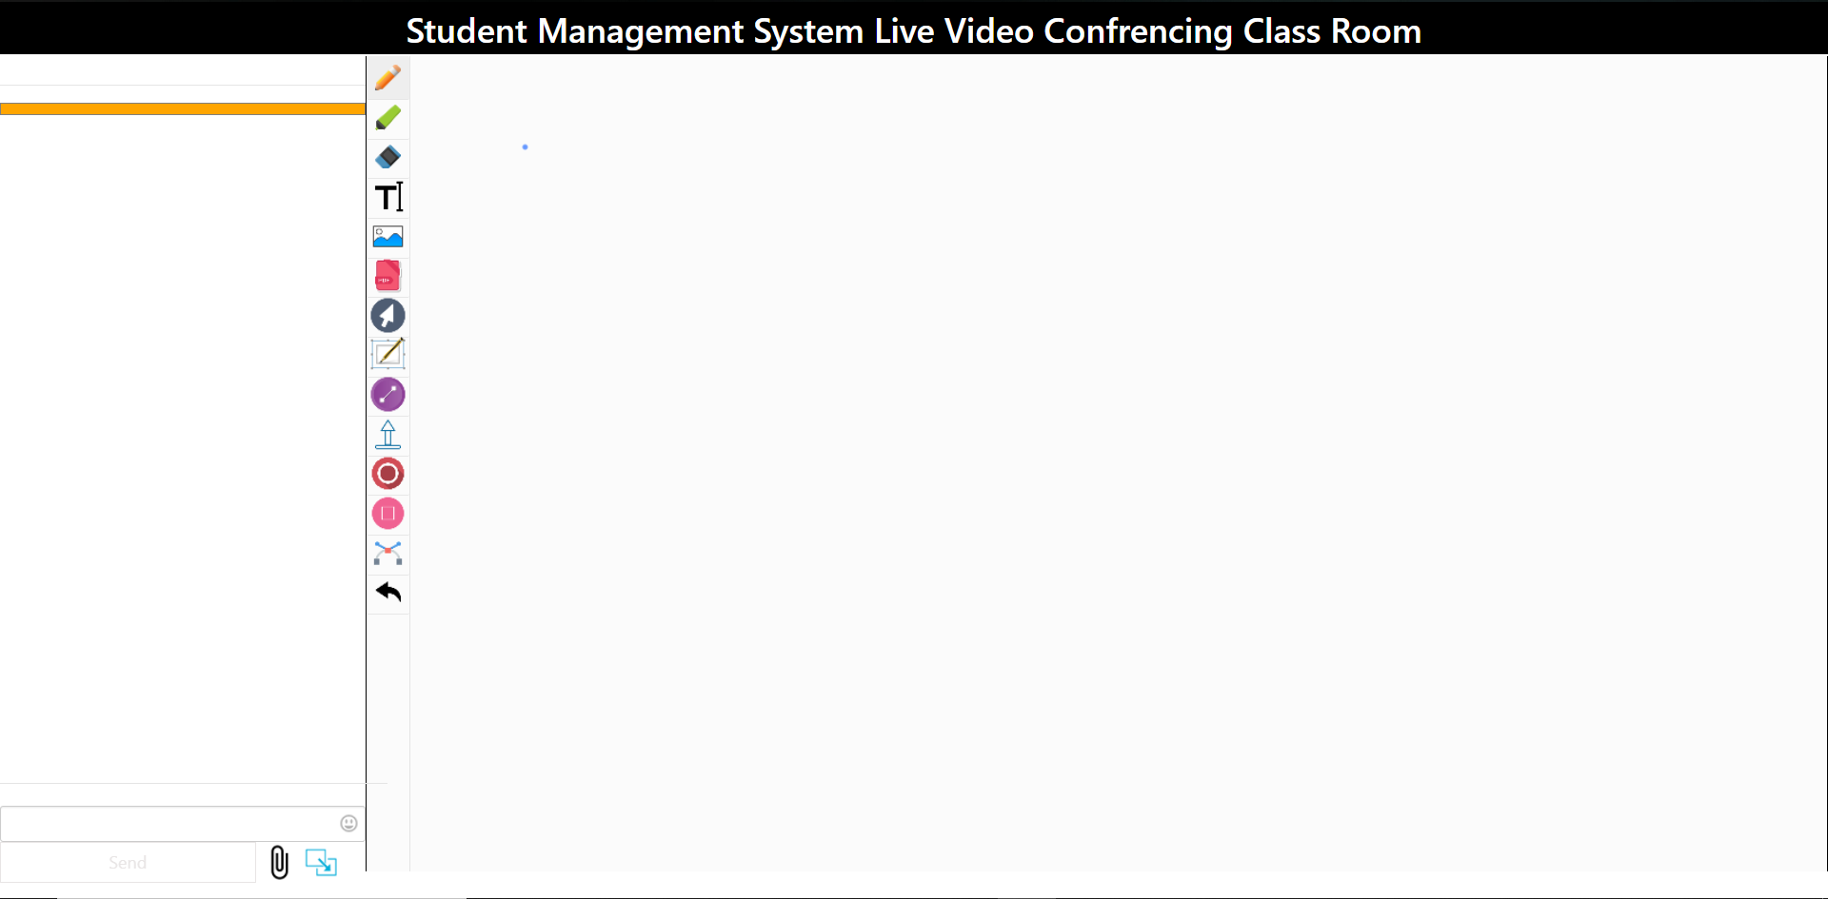
Student management in django
Home
Take Attendance
View Update Attendance
Apply Leave
Feedback
Add Result
Staff
Edit Result
Start Live Classroom
Notifications

Slide 53
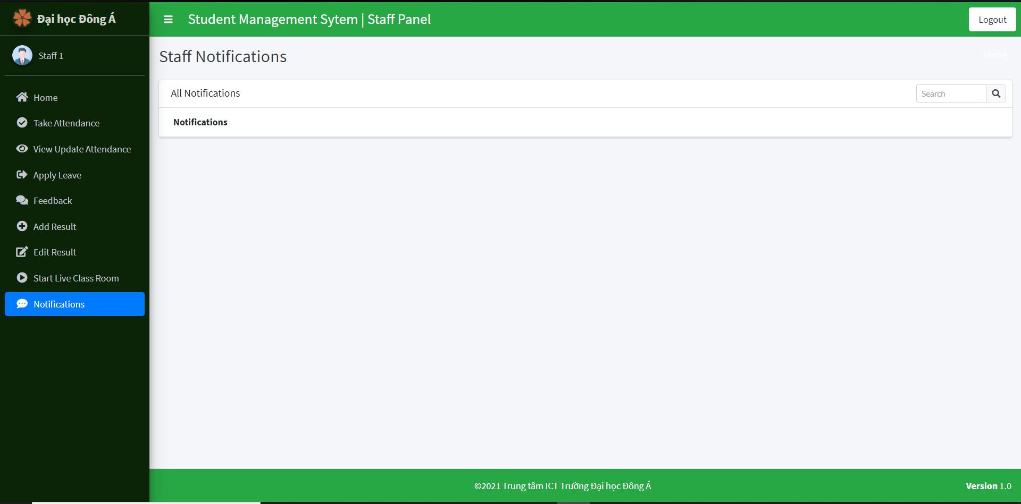
Student management in django
Home
Take Attendance
View Update Attendance
Apply Leave
Feedback
Add Result
Staff
Edit Result
Start Live Classroom
Notifications

Slide 54
Student management in django
Summary details
Summary details of interior functions of the project.

Slide 55
Student management in django
Design part: Establish the initial modules & the dedicated database.
Summary details of interior functions of the project.
Closely Observe for project by deploying the code and testing.
Conculsion: reaching to conclusion of the project using Django.

Slide 56
Student management in django
Closely Observe for project by deploying the code and testing.

Slide 57
Student management in django
Design part: Establish the initial modules & the dedicated database.
Summary details of interior functions of the project.
Closely Observe for project by deploying the code and testing.
Conculsion: reaching to conclusion of the project using Django.

Slide 58
Student management in django
Conculsion: reaching to conclusion of the project using Django.

Slide 59
THANKS FOR WATCHING

